Slide 1

ECE201R01 : Microprocessor & Microcontroller
Unit I: 8086 Register Array
8086 - Register Array

Slide 2
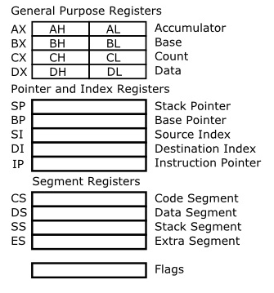
Register Array in 8086
8086 - Register Array

Slide 3
Registers
AX:
  I/O operations pass data through AX (or AL).
  Several string instructions requires one of the operands to be in AX (or AL).
  In 32-bit Multiply & Divide instructions AX is used to hold lower-order word operand.
  In 16-bit Multiply & Divide operations AX contains the one-word operand and result, whereas AL is used for 8-bit operations.
BX:
  Used as base register while computing data memory address.
8086 - Register Array

Slide 4
Registers
CX:
  It can be used to hold the count in multi-iteration instructions. In looping & repeat instructions CX can hold the desired number of repetitions & is automatically decremented after each iteration.
  When CX becomes zero the instruction execution is terminated.
  CL register is used in bit-shift & rotate instructions.
DX:
  It is used in certain I/O instructions.
  In 32-bit Multiply & Divide instructions DX is used to hold higher-order word operand.
8086 - Register Array

Slide 5
Registers
Stack Pointer (SP): used in instructions which use stack, i.e. PUSH, POP, CALL, RET, etc.
Base Pointer (BP): provide indirect access to data in stack register. Also used for general data storage.
Source index (SI) and Destination index (DI): to store offset in case of indexed, base indexed and relative base indexed addressing modes. Also used for general data storage.
Instruction Pointer (IP): also referred as Program Counter. Used for the calculation of actual memory addresses of instructions. It stores the offset for the instruction (code segment).
8086 - Register Array

Slide 6
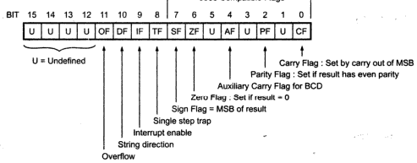
Flag Register in 8086
8086 - Register Array

Slide 7
Flag Register in 8086
Zero Flag (ZF) - set if the result is zero.
Auxiliary carry Flag (AF) - set if there was a carry from or borrow to bits 0-3 in the AL register.
Parity Flag (PF) - set if parity (the number of 1s) in the of the result is even.
Carry Flag (CF) - set if there was a carry from or borrow to the most significant bit during last result calculation.
Sign Flag (SF) - set if the most significant bit of the result is set.
8086 - Register Array

Slide 8
Flag Register in 8086
Overflow Flag (OF) - set if the result is too large positive number, or is too small negative number to fit into destination operand.
Direction Flag (DF) - if set then string manipulation instructions will auto-decrement index registers. If cleared then the index registers will be auto-incremented.
Interrupt-enable Flag (IF) - setting this bit enables maskable interrupts.
Trap Flag (TF) - if set then single-step interrupt will occur after the next instruction.
8086 - Register Array

Slide 9
Thank you . . .
8086 - Register Array

